Slide 1


SPIRAL MODEL
ANANNYA MISHRA

Slide 2

Agenda
Introduction
Phases of Spiral Model
Key Characters
Advantages & Disadvantage
When to Use Spiral Model

Slide 3

Introduction To Spiral Model

Slide 4
SPIRAL MODEL
The Spiral Model is a software development methodology that combines elements of both iterative and waterfall models.
It is particularly useful for large, complex, and high-risk projects.
The spiral model is used by software engineers and is favored for large, expensive and complicated projects.
The Spiral Model was first proposed by Barry Boehm

Slide 5
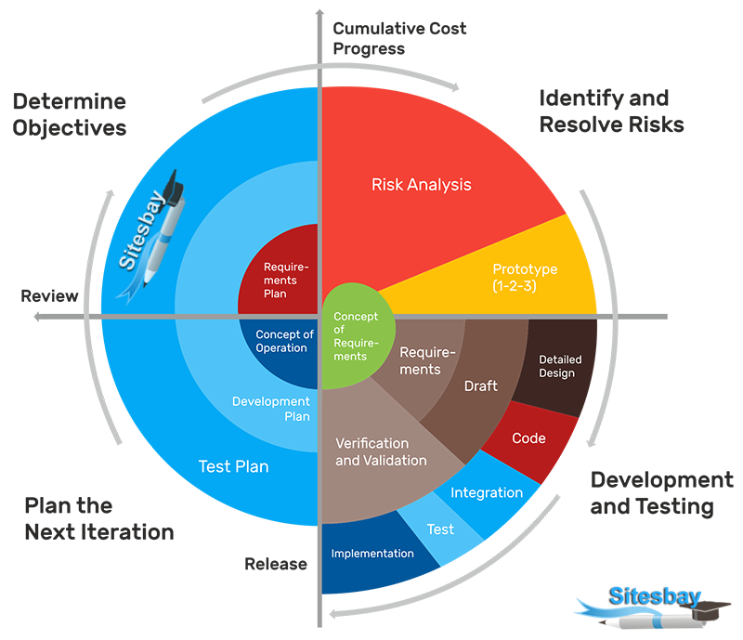
SPIRAL MODEL

Slide 6

Phase Of Spiral Model

Slide 7
Phases of the Spiral Model
Planning Phase: Initial planning of the project,
defining objectives, constraints, and identifying risks.
Risk Analysis Phase: Identifying and evaluating
potential risks, such as technical feasibility and
schedule delays.
Engineering Phase: Actual development of the
software, including design, coding, testing, and
integration.
Evaluation Phase: Reviewing progress with
stakeholders and users. Feedback is gathered
and used to refine the project.
These phases are iterated in a spiral pattern,
each loop focusing on a different set of objectives.

Slide 8
Key Characteristics
Iterative Process: The project progresses through
repeated cycles (or spirals), allowing for refinement
and adjustment at each stage.
Risk Management: One of the distinguishing features
of the Spiral Model is its emphasis on identifying
and managing risks early in the process.
Prototyping: Prototypes are developed and tested in
each iteration, allowing for gradual improvement of
the product.
Flexibility: The model is flexible, allowing for changes
and refinements based on feedback after each spiral.
Customer Involvement: Clients and users are involved
at each phase, ensuring that their needs are met and that
the product is aligned with expectations.

Slide 9
ADVANTAGES & DISADVANTAGES
Risk Management: The focus on risk analysis in every iteration allows for early identification of potential problems.
Flexibility and Adaptation: Changes can be incorporated into the design at any phase based on feedback or evolving requirements.
Clear Objectives: Well-defined objectives and milestones help ensure that the project stays on track.
Customer Feedback: Regular customer involvement helps ensure the final product meets their expectations.
Complexity: The model can be difficult to manage due to its iterative nature and the need for continuous planning and risk assessment.
Resource-Intensive: The focus on constant iteration, risk analysis, and prototyping requires significant time and effort from both developers and stakeholders.
Not Suitable for Small Projects: The Spiral Model is best suited for large, complex projects and may not be efficient for smaller, less critical projects.

Slide 10

When to Use the Spiral Model
Projects with high risks and uncertain requirements.
Large-scale projects that need frequent revisions and feedback from users.
Projects that require prototyping and iterative development.
Projects where long-term commitment and detailed planning are essential.

Slide 11
When to Use the Spiral Model
The model starts with initial planning at the center and progressively expands as development moves through planning, risk analysis, engineering, and evaluation phases.
The Spiral Model is well-suited for projects where risk management and continuous improvement are key priorities.

Slide 12
Thank you
Anannya Mishra

